Slide 1
Introduction to Git and GitHub
K.M. TANVIR AHMED ROLL : 1407014

Slide 2
What Is Git?
+ Version Control Software It means while you coding, you can save; each little time you make a change so if you make a mistake, then you've undo option or you can look back how was it before!
+ Open Source
you can use it without paying.

Slide 3
What Is GitHub?
+ Collaboration Website
GitHub is a collaboration website that interacts with Git and works with it on the projects that you work on in your version control system.
* you will use it to collaborate with your peers on projects using version control.

Slide 4
>>Think it for a moment!
Why use something like Git?

Slide 5
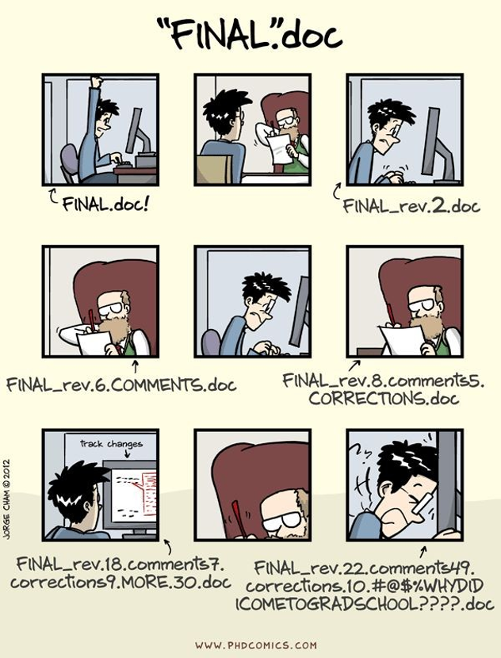
PROBLEMS>>

Slide 6
Say you and a coworker are both updating pages on the same website. You make your changes, save them, and upload them back to the website. The problem comes when your coworker is working on the same page as you at the same time. One of you is about to have your work overwritten and erased.
As we know Git is version control software: which means it manages changes to a project without overwriting any part of that project. And it’s not going away anytime soon. A version control application like Git keeps that from happening. You and your coworker can each upload your revisions to the same page, and Git will save two copies. Later, you can merge your changes together without losing any work along the way. You can even revert to an earlier version at any time, because Git keeps a “snapshot” of every change ever made.

Slide 7
Shell
terminal, command line, Bash, etc
An application that lets you communicate with your operating system.
Command-line interface (CLI)
read-evaluate-print loop (REPL)
On Windows use Git Bash for Unix-like commands so you can follow Mac or Linux tutorials.

Slide 8
SETUP
Configuring user information used across all local repositories
git config --global user.name “[firstname lastname]”
set a name that is identifiable for credit when review version history
git config --global user.email “[valid-email]”
set an email address that will be associated with each history marker
git config --global color.ui auto
set automatic command line coloring for Git for easy reviewing

Slide 9
git status show modified files in working directory, staged for your next commit git add [file] add a file as it looks now to your next commit (stage) git reset [file] unstage a file while retaining the changes in working directory git commit -m “[descriptive message]”
STAGE & SNAPSHOT
Working with snapshots and the Git staging area

Slide 10
TRACKING PATH CHANGES Versioning file removes and path changes
git rm [file] delete the file from project and stage the removal for commit git mv [existing-path] [new-path] change an existing file path and stage the move

